Slide 1

AP Computer Science A Exam Review
What you ABSOLUTELY MUST KNOW above everything else
(according to the Barron’s test prep book)

Slide 2

The Basics
Every AP exam question uses at least one of these:
Types and Identifiers
Operators
Control structures

Slide 3

Identifiers
Identifiers – name for variable, parameter, constant, user-defined method/class, etc.
Convention says identifiers for variables and methods will be lowercase (with uppercase letters to separate multiple words)
E.g. getName, findSurfaceArea, preTaxTotal
Class names will be capitalized
E.g. Student, Car, BankAccount

Slide 4

Built-in/Primitive Types
int
an integer, e.g. 5, -77, 9001
boolean
a boolean, true or false
double
a double precision floating-point number, 2.718, -3456.78, 1.4e5

Slide 5

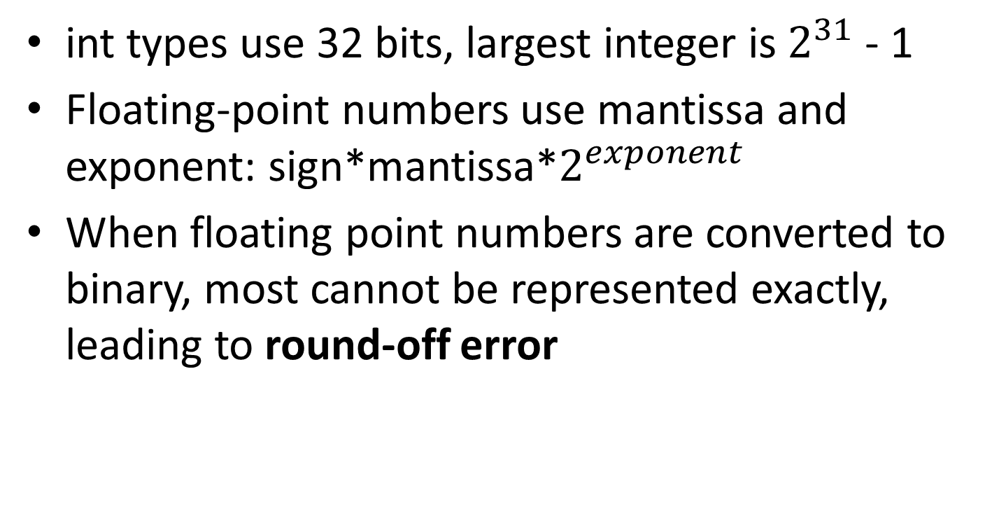
Storage of numbers
int types use 32 bits, largest integer is $2^{31}$ - 1
Floating-point numbers use mantissa and exponent: sign*mantissa*$2^{exponent}$
When floating point numbers are converted to binary, most cannot be represented exactly, leading to round-off error

Slide 6

Miscellaneous Note #1
Integer.MIN_VALUE and Integer.MAX_VALUE
Represent the absolute lowest and highest values that can be stored in an integer
If you’re trying to find the minimum or maximum value of an array or ArrayList, initialize your variable to these

Slide 7

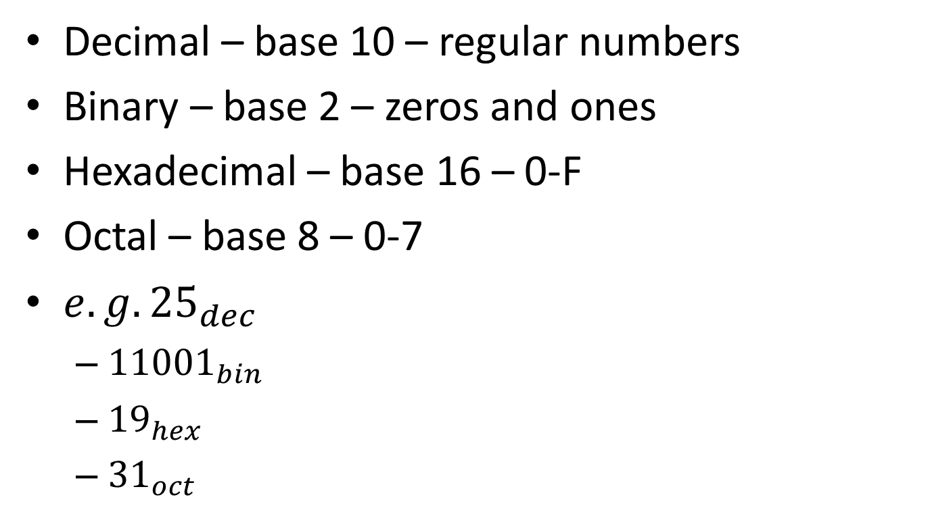
Number representation
Decimal – base 10 – regular numbers
Binary – base 2 – zeros and ones
Hexadecimal – base 16 – 0-F
Octal – base 8 – 0-7
$e.g. {25}_{dec}$
${11001}_{bin}$
${19}_{hex}$
${31}_{oct}$

Slide 8

Final Variables
final variable is a quantity whose value will not change
E.g. final int CLASS_SIZE = 30

Slide 9

Arithmetic Operators
Operator | Meaning | Example
+ | Addition | 3 + x
- | Subtraction | p – q
* | Multiplication | 6 * i
/ | Division | 10 / 4 //returns 2
% | Mod (remainder) | 11 % 8 //returns 3

Slide 10

Arithmetic Operators Notes
Integer division truncates the answer (cuts off the decimal)
Use type casting to control how to divide.
Which do not evaluate to 0.75?
3.0 / 4
3 / 4.0
(int) 3.0 / 4
(double) 3 / 4
(double) (3 / 4)

Slide 11

Relational Operators
Operator | Meaning | Example
== | Equal to | if (x == 100)
!= | Not equal to | if (age != 21)
> | Greater than | if (salary > 30000)
< | Less than | if (grade < 65)
>= | Greater than or equal to | if (age >= 16)
<= | Less than or equal to | if (height <= 6)

Slide 12

Relational Operators Notes
Should only be used for primitive types (i.e. int, double, boolean)
Be careful for comparing floating-point numbers due to round-off error

Slide 13

Logical Operators
Operator | Meaning | Example
! | NOT | if (!found)
&& | AND | if (x < 3 && y > 4)
|| | OR | if (age < 2 || height < 4)

Slide 14

Logical Operators Example
(x && y) || !(x && y)
Always true
Always false
true only when x is true and y is true
true only when x and y have the same value
true only when x and y have different values

Slide 15

Another example
Which is equivalent to: !(a < b) && !(a > b)
true
false
a == b
a != b
!(a < b) && (a > b)

Slide 16

Assignment Operators
Operator | Example | Meaning
= | x = 2 | Simple assignment
+= | x += 4 | x = x + 4
-= | y -= 6 | y = y – 6
*= | p *= 5 | p = p * 5
/= | n /= 10 | n = n / 10
%= | n %= 10 | n = n % 10
++ | k++ | k = k + 1
-- | i-- | i = i - 1

Slide 17

Operator Precedence
(1) !, ++
(2) *, /, %
(3) +, -
(4) <, >, <=, >=
(5) ==, !=
(6) &&
(7) ||
(8) =, +=, -=, *=, /=, %=

Slide 18

Control Structures
if
if…else
if…else if
while loop
for loop
for-each loop

Slide 19

if Statement
if (boolean expression)
{
statements
}
//statements will be executed if boolean expression is true

Slide 20

if example
3 bonus questions → must get all correct for 5 points added to grade
bonus1, bonus2, and bonus3 are boolean variables that indicate whether they are correct
Write an if statement for this example
if(bonus1 && bonus2 && bonus3) grade += 5;

Slide 21

if…else Statement
if (boolean expression)
{
statements //will be executed if boolean expression is true
}
else
{
statements
//will be executed if boolean expression is false
}

Slide 22

if…else if
if (grade.equals(“A”)) System.out.println(“Excellent”); else if(grade.equals(“B”)) System.out.println(“Good”); else if(grade.equals(“C”)) System.out.println(“Poor”); else System.out.println(“Invalid”);

Slide 23

Other if Notes
if/if…else if statements do not always need an else at the end
An if statement inside of an if statement is a nested if statement: if (boolean expr1) if (boolean expr2) statement;
Can also be written as: if (boolean expr1 && boolean expr2) statement;

Slide 24

Rewrite using only if…else
if(value < 0) return “Not in range”; else if(value > 100) return “Not in range”; else return “In range”;
if(value < 0 || value > 100) return “Not in range”; else return “In range”;

Slide 25

While vs. For loops
While loops
For loops
int i = 0; while (i < 100) { //repeated code i++; }
for(int i = 0; i<100; i++) { //repeated code }

Slide 26

While vs. For-each loops
While loop
For-each loop
int[] locationCells = new int[100]; int i = 0; while (i < 100) { System.out.println (locationCells[i]); i++; }
int[] locationCells = new int[100]; for(int cell : locationCells) { System.out.println(cell); }

Slide 27

For loop vs. for-each loop
For loop
For-each loop
for(int i = 0; i<100; i++) { System.out.println (locationCells[i]); }
for(int cell : locationCells) { System.out.println(cell); }

Slide 28

For loop vs. for-each loop
For loop
For-each loop
Has an index → useful for setting data that depends on the index
Initialization, boolean test, and iteration expression are all in one line
Easier to write when simply accessing data from an array
Not much better than a while loop if not accessing array data

Slide 29

While loop example
int value = 15; while (value < 28) { System.out.println(value); value++; }
What is the first number printed?
15
What is the last number printed?
27

Slide 30

Another example
int a = 24; int b = 30; while (b != 0) { int r = a % b; a = b; b = r; } System.out.println(a);
0
6
12
24
30

Slide 31

Yet another example
int k = 0; while (k < 10) { System.out.print ((k % 3) + “ ”); if ((k % 3) == 0) k = k + 2; else k++; }
0 2 1 0 2
0 2 0 2 0 2
0 2 1 0 2 1 0
0 2 0 2 0 2 0
0 1 2 1 2 1 2

Slide 32

For loop example
String str = “abcdef”; for (int r = 0; r < str.length()-1; r++) System.out.print(str.substring(r, r+2));
What is printed?
abcdef
aabbccddeeff
abbccddeef
abcbcdcdedef
Nothing, IndexOutOfBoundsException thrown

Slide 33

Another example
public void numberCheck(int maxNum) { int typeA = 0; int typeB = 0; int typeC = 0; for (int k = 1; k<=maxNum; k++) { if (k%2 == 0 && k%5==0) typeA++; if (k%2 == 0) typeB++; if (k%5 == 0) typeC++; } System.out.println(typeA + “ ” + typeB + “ ” + typeC); }
What is printed by numberCheck(50)?
5 20 5
5 20 10
5 25 5
5 25 10
30 25 10

Slide 34

Yet another example
for (int outer = 0; outer < n; outer++) for(int inner = 0; inner <= outer; inner++) System.out.print(outer + “ ”);
If n has a value of 4, what is printed?
0 1 2 3
0 0 1 0 1 2
0 1 2 2 3 3 3
0 1 1 2 2 2 3 3 3 3
0 0 1 0 1 2 0 1 2 3

Slide 35

Objects, Classes, and Inheritance
You may have to write your own class. You’ll definitely need to interpret at least one class that’s given. Very common, esp. on FRQ.
Methods
Subclasses
Abstract classes
Interfaces

Slide 36

Method Headers
With the exception of constructors, all method headers should have these 4 things:
Access modifier: public, private
Return type: void, int, double, boolean, SomeType, int[], double[], Pokemon[], etc.
Method name: e.g. withdraw
Parameter list: e.g. String pass, double amt
(Some methods may also be static)
public void withdraw(String pass, double amt)

Slide 37

Types of Methods
Constructors → create an object of the class
public BankAccount()
Accessor → gets data but doesn’t change data
public double getBalance()
Mutator → changes instance variable(s)
public void deposit(String pswd, double amt)
Static methods → class methods, deals with class variables
public static int getEmployeeCount()

Slide 38

Static methods in Driver class
Methods in the driver class (the class that contains your main() method) are usually all static because there are not instances of that class.
public static void main(String[] args)

Slide 39

Method Overloading
Two or more methods with the same name but different parameter lists
public int product(int n) {return n*n;}
public double product(double x) {return x*x;}
public double product(int x, int y){return x*y;}
(return type is irrelevant for determining overloading)

Slide 40

Inheritance
Inheritance is where a subclass is created from an existing superclass.
The subclass copies or inherits variables and methods from the superclass
Subclasses usually contain more than their superclass
Subclasses can be superclasses for other subclasses

Slide 41

Class hierarchy - Which is true?
Superclass should contain the data and functionality that are common to all subclasses that inherit from the superclass
Superclass should be the largest, most complex class from which all other subclasses are derived
Superclass should contain the data and functionality that are only required for the most complex class
Superclass should have public data in order to provide access for the entire class hierarchy
Superclass should contain the most specific details of the class hierarchy

Slide 42

Implementing Subclasses
Subclasses copy everything except what?
public class Superclass { //superclass variables and methods }
public class Subclass extends Superclass { //copies everything from Superclass //EXCEPT constructors }

Slide 43

Inheriting Instance Methods/Variables
Subclasses cannot directly access private variables if they are inherited from a superclass
Subclasses must use the public accessor and mutator methods
(Subclasses can directly access if variables are protected but protected is not in the AP Java subset.)

Slide 44

Method Overriding and super
If a method has the same name and parameter list in both the superclass and subclass, the subclass method overrides the superclass method
To invoke the method from the superclass, use the keyword super
E.g. if the superclass has a computeGrade() method, use super.computeGrade()
If you are invoking the constructor use super() or super(parameters)

Slide 45

Rules for Subclasses
Can add new private instance variables
Can add new public, private, or static methods
Can override inherited methods
May not redefine a public method as private
May not override static methods of superclass
Should define its own constructors
Cannot directly access the private members of its superclass, must use accessors or mutators

Slide 46

Declaring Subclass Objects
Superclass variables can reference both superclass objects and subclass objects
Which of these is not valid:
Student c = new Student();
Student g = new GradStudent();
Student u = new UnderGrad();
UnderGrad x = new Student();
UnderGrad y = new UnderGrad();

Slide 47

Polymorphism
Method overridden in at least one subclass is polymorphic
What are method calls are determined by?
the type of the actual object
the type of object reference
Selection of correct method occurs during the run of the program (dynamic binding)

Slide 48

Type Compatibility
Only polymorphic if method is overridden
E.g. if GradStudent has a getID method but Student does not, this will lead to a compile-time error: Student c = new GradStudent(); int x = c.getID(); //compile-error
You can cast it as a subclass object to fix the error: int x = ((GradStudent) c).getID();

Slide 49

Abstract Class
Superclass that represents an abstract concept
Should never be instantiated
May contain abstract methods
When no good default code for superclass
Every subclass will override abstract methods
If class contains abstract methods, it must be declared an abstract class

Slide 50

Notes about abstract classes
Can have both abstract and non-abstract methods
Abstract classes/methods are declared with keyword abstract
Possible to have abstract class without abstract methods
Abstract classes may or may not have constructors
Cannot create abstract object instances
Polymorphism still works

Slide 51

Interfaces
Collection of related methods whose headers are provided without implementations
Classes that implement interfaces can define any number of methods
Contracts to implement all of them; if cannot implement all, must be declared an abstract class
Interface keyword for interfaces; implements keyword for class that implement them
Class can extend a superclass and implement an interface at the same time: public class Bee extends Insect implements FlyObject

Slide 52

Interface vs. Abstract Class
Use abstract class for object that is application-specific, but incomplete without subclasses
Consider interface when methods are suitable for your program but also equally applicable in a variety of programs
Interface cannot provide implementations for any of its methods; abstract class can
Interface cannot have instance variables; abstract class can
Both can declare constants
Both cannot create an instance of itself

Slide 53

Miscellaneous Note #2
List → basically the same as ArrayList
List is an interface
ArrayList implements List

Slide 54

Lists and Arrays
Manipulate a list. Search, delete and insert an item. Very common on the AP exam.
One-dimensional arrays
ArrayLists
Two-dimensional arrays

Slide 55
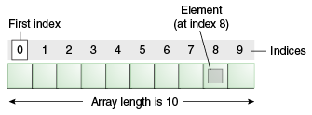

1-D Arrays

Slide 56

1-D Array Initialization
Which of these are valid ways to assign a reference to an array?
double[] data = new double[25];
double data[] = new double[25];
double[] data; data = new double[25];
All are three are valid!

Slide 57
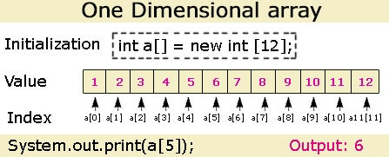


Slide 58

1-D initializing values
Small arrays can have values initialized with either of the following ways:
int[] coins = new int[4]; coins[0] = 1; coins[1] = 5; coins[2] = 10; coins[3] = 25;
int[] coins = {1, 5, 10, 25};

Slide 59

Array Length
length is a public instance variable of arrays: String[] names = new String[25]; names.length; //returns 25
Array indices go from 0 to names.length-1 (i.e. 0 to 24)
length is not a method for arrays; length is a method for Strings

Slide 60

Traversing an Array
Use for-each loop when you need to access (only access) every element in an array without replacing or removing elements
Use for loop for all other cases

Slide 61

What to do with arrays
You need to be able to read and write code that accomplishes each of the following:
Counting elements
Printing elements
Summing elements
Swapping elements
Finding the minimum or maximum
Inserting elements
Deleting elements

Slide 62

Counting & Printing
Counting: int total = 0; for(int i = 0; i<arr.length; i++) { total++; }
Printing: for(int i = 0; i<arr.length; i++) { System.out.println(arr[i]); }

Slide 63

Summing Values
The method calcTotal is intended to return the sum of all values in vals.
private int[] vals; public int calcTotal() { int total = 0; /* missing code */ return total; }
What code should replace /* missing code */ in order for calcTotal to work correctly?

Slide 64

Summing Values
private int[] vals; public int calcTotal() { int total = 0; for(int pos = 0; pos < vals.length; pos++) { total += vals[pos]; } return total; }

Slide 65

Summing Values
private int[] vals; public int calcTotal() { int total = 0; int pos = 0; while (pos < vals.length) { total += vals[pos]; pos++; } return total; }

Slide 66

Swapping values
int[] arr = new int[10];
How to swap arr[0] and arr[5]?
arr[0] = 5; arr[5] = 0;
arr[0] = arr[5]; arr[5] = arr[0];
int k = arr[5]; arr[0] = arr[5]; arr[5] = k
int k = arr[0]; arr[0] = arr[5]; arr[5] = k;
int k = arr[5]; arr[5] = arr[0]; arr[0] = arr[5];

Slide 67

Min and Max
int min = arr[0]; for(int j = 0; j<arr.length; j++){ if (arr[j]<min) min = arr[j]; }
int max = arr[0]; for(int j = 0; j<arr.length; j++){ if (arr[j]>max) max = arr[j]; }

Slide 68

Arrays vs. ArrayList
Arrays
ArrayList
String[] arr = new String[10]; … //insert Strings into array … for(int i=0; i<arr.length; i++) { System.out.println(arr[i]); }
ArrayList<String> arrList = new ArrayList<String>(); … //insert Strings into ArrayList … for(int i=0; i<arr.size(); i++) { System.out.println (arrList.get(i)); }

Slide 69

Arrays vs. ArrayList
Arrays
ArrayList
String[] arr = new String[10]; … //insert Strings into array … for(String x : arr) { System.out.println(x); }
ArrayList<String> arrList = new ArrayList<String>(); … //insert Strings into ArrayList … for(String x : arrList) { System.out.println(x); }

Slide 70

Arrays vs. ArrayList
Arrays
ArrayList
Fixed length, set when it is created Must keep track of last slot if array is not full Must write code to shift elements if you want to insert or delete
Shrinks and grows as needed Last slot is always arrList.size()-1 Insert with just arrList.add(object) Delete with just arrList.remove(objectIndex) or arrList.remove(object)

Slide 71

Insert and Delete
If asked to insert or delete for arrays, you’ll likely need to create a new array
More likely asked about ArrayLists
ArrayLists can change length more easily

Slide 72

ArrayList Question
ArrayList<String> items = new ArrayList<String>(); items.add(“A”); items.add(“B”); items.add(“C”); items.add(0, “D”); items.remove(3); items.add(0, “E”); System.out.println(items);
[A, B, C, E]
[A, B, D, E]
[E, D, A, B]
[E, D, A, C]
[E, D, C, B]

Slide 73

Another ArrayList Question
public void replace(ArrayList<String> nameList, String name, String newValue) { for (int j = 0; j<nameList.size(); j++) { if( /* expression */ ) nameList.set(j, newValue); } }
What should be used to replace /*expression*/ so that the replace method will replace all occurrences of name in nameList with newValue?
nameList.get(j).equals(name)

Slide 74

removeAll
Write the removeAll method that will remove all instances of String str from ArrayList arrList and return the number of items removed
public int removeAll(ArrayList<String> arrList, String str) { /* complete this method */ }

Slide 75

removeAll
public int removeAll(ArrayList<String> arrList, String str) { int numRemoved = 0; for (int i = arrList.size()-1; i>=0; i--) { if(str.equals(arrList.get(i)) { numRemoved += 1; arrList.remove(i); } } }

Slide 76
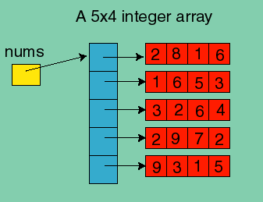

2-D Arrays
int[][] nums = new int[5][4];

Slide 77


2-D Array as a table
int numRows = 3;
int numCols = 3;
String[][] table = new String[numRows][numCols];
table[2][0] = “x”;

Slide 78
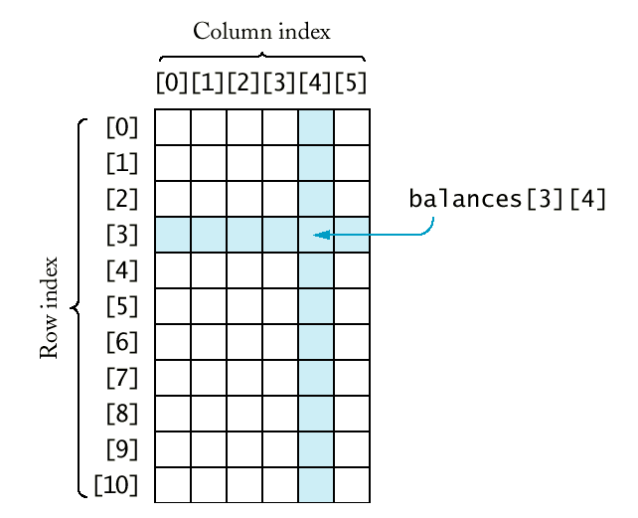


Slide 79

2-D Array Question
public void alter(int c) { for (int i = 0; i<mat.length; i++) for (int j = c+1; j<mat[0].length; j++) mat[i][j-1] = mat[i][j]; }
mat is a 3x4 matrix with values: 1 3 5 7 2 4 6 8 3 5 7 9
alter(1) will change mat to what?
1 5 7 7 2 6 8 8 3 7 9 9

Slide 80

Sorting and Searching
Know these algorithms; at least one or two questions on AP exam
Selection Sort
Insertion Sort
Merge Sort
Binary Search

Slide 81

Selection Sort Algorithm (ascending)
“Search and swap” algorithm:
Find smallest element (of remaining elements).
Swap smallest element with current element (starting at index 0).
Finished if at the end of the array. Otherwise, repeat 1 and 2 for the next index.

Slide 82

Selection Sort Example(ascending)
70 75 89 61 37
Smallest is 37
Swap with index 0
37 75 89 61 70
Smallest is 61
Swap with index 1
37 61 89 75 70
Smallest is 70
Swap with index 2
37 61 70 75 89
Smallest is 75
Swap with index 3
Swap with itself
37 61 70 75 89
Don’t need to do last element because there’s only one left
37 61 70 75 89

Slide 83

Selection Sort Question
In an array of Integer contains the following elements, what would the array look like after the third pass of selectionSort, sorting from high to low? 89 42 -3 13 109 70 2
109 89 70 13 42 -3 2
109 89 70 42 13 2 -3
109 89 70 -3 2 13 42
89 42 13 -3 109 70 2
109 89 42 -3 13 70 2

Slide 84

Selection Sort Notes
For an array of n elements, the array is sorted after n-1 passes
After the kth pass, the first k elements are in their final sorted position
Inefficient for large n

Slide 85

Insertion Sort Algorithm (ascending)
Check element (store in temp variable)
If larger than the previous element, leave it
If smaller than the previous element, shift previous larger elements down until you reach a smaller element (or beginning of array). Insert element.

Slide 86

Insertion Sort Algorithm (ascending)
64 54 18 87 35
54 less than 64
Shift down and insert 54
54 64 18 87 35
18 less than 64
18 less than 54
Shift down and insert 18
18 54 64 87 35
87 greater than 64
Go to next element
18 54 64 87 35
35 less than 87
35 less than 64
35 less than 54
35 greater than 18
Shift down and insert 35
18 35 54 64 87

Slide 87

Insertion Sort Question
When sorted biggest to smallest with insertionSort, which list will need the greatest number of changes in position?
5,1,2,3,4,7,6,9
9,5,1,4,3,2,1,0
9,4,6,2,1,5,1,3
9,6,9,5,6,7,2,0
3,2,1,0,9,6,5,4

Slide 88

Insertion Sort Question
A worst case situation for insertion sort would be which of the following?
A list in correct sorted order
A list sorted in reverse order
A list in random order

Slide 89

Insertion Sort Notes
For an array of n elements, the array is sorted after n-1 passes
After the kth pass, a[0], a[1],…, a[k] are sorted with respect to each other but not necessarily in their final sorted positions
Worst case occurs if array is initially sorted in reverse order
Best case occurs if array is already sorted in increasing order
Inefficient for large n

Slide 90

Merge Sort Algorithm
The idea behind merge sort is divide and conquer
Divide data into 2 equal parts
Recursively sort both halves
Merge the results

Slide 91
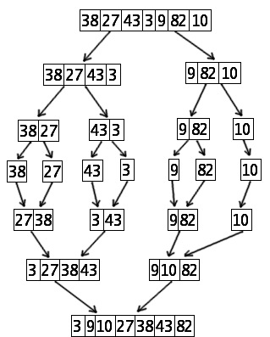

Merge Sort Example
Divide data into 2 equal parts
Recursively sort both halves
Merge the results

Slide 92

Merge Sort Example
8 45 87 34 28 45 2 32 25 78
8 45 87 34 28 | 45 2 32 25 78
8 45 87 | 34 28 | 45 2 32 | 25 78
8 45 | 87 | 34 | 28 | 45 2 | 32 | 25 | 78
8 | 45 | 87 | 34 | 28 | 45 | 2 | 32 | 25 | 78
8 45 | 87 | 28 34 | 2 45 | 32 | 25 78
8 45 87 | 28 34 | 2 32 45 | 25 78
8 28 34 45 87 | 2 25 32 45 78
2 8 25 28 32 34 45 45 78 87

Slide 93

Merge Sort Notes
Main disadvantage of Merge sort is use of a temporary array→problem if space is a factor
Merge sort is not affected by the initial ordering of the elements→best and worst case take the same amount of time

Slide 94

Merge Sort Question
Which of the following is a valid reason why mergesort is a better sorting algorithm than insertion sort for sorting long lists?
Mergesort requires less code than insertion sort
Mergesort requires less storage space than insertion sort
Mergesort runs faster than insertion sort

Slide 95

Binary Search
Check middle element
Is this what we’re looking for? If so, we’re done.
Does what we’re looking for come before or after?
Throw away half we don’t need
Repeat with half we do need
What does this look like in Java?

Slide 96

Recursive
Binary search is recursive
Uses indices to know where to search in the array
Calculate an index midway between the two indices
Determine which of the two subarrays to search
Recursive call to search subarray

Slide 97

Binary Search Question
Which of the following is not true of a binary search of an array?
The method involves looking at each item in the array, starting at the beginning, until either the value being searched for is found or it can be determined that the value is not in the array.
In order to use the binary search, the array must be sorted first.
The method is referred to as “divide and conquer.”
An array of 15 elements requires at most 4 comparisons.
Using a binary search is usually faster than a sequential search.

Slide 98

How many executions?
Check how many halves you threw away + 1
Or check how many times you checked a middle element

Slide 99

Binary Search Question
A binary search is to be performed on an array with 600 elements. In the worst case, which of the following best approximates the number of iterations of the algorithm?
6
10
100
300
600

Slide 100

Binary Search Question
Consider a binary search algorithm to search an ordered list of numbers. Which of the following choices is closest to the maximum number of times that such an algorithm will execute its main comparison loop when searching a list of 1 million numbers?
6
20
100
120
1000

Slide 101

The GridWorld Case Study
Bugs and Critters are 25% of the exam
Bug Class
BoxBug Class
Critter Class
ChameleonCritter Class

Slide 102

Bug Methods
public Bug()
Default constructor. Creates red Bug.
public Bug(Color bugColor)
Constructor. Create Bug with said color.
Note: both constructors use inherited setColor method
public void act()
Bug moves if possible; otherwise turns.
Note: only overridden method of Actor class
public void turn()
Turns Bug 45⁰ to right without changing location (i.e. add Location.HALF_RIGHT to current direction)

Slide 103

Bug Methods (cont.)
public boolean canMove()
Get bug’s grid, if null, return false (null if another actor removed the bug).
Get adjacent location in front of bug.
If location is invalid, return false.
Get actor in neighboring location.
If actor is flower or null, return true. Otherwise, return false.

Slide 104

Bug Methods (cont.)
public void move()
Get bug’s grid, if null, exit method.
Get bug’s current location
Get adjacent location in front of bug
If location is valid, bug moves there. Otherwise, removes itself from grid.
Creates a flower that is same color as bug
Place flower in bug’s previous location

Slide 105

BoxBug Variables
sideLength
number of steps in a side of its square
steps
keeps track of where the BoxBug is in creating a side

Slide 106

BoxBug Methods
public BoxBug(int length)
Constructor. Set sidelength to said length and initializes steps to 0
public void act()
overridden method performs one step each call
checks to see if steps<sidelength and canMove
if true, move; else, turn twice

Slide 107

Critter Class
No explicit constructor; uses default constructor
Extends Actor with following behavior:
public void act()
Get a list of neighboring actors
Process actors
Get list of possible locations to move to
Select location from list
Move to location

Slide 108

Critter Methods
public void act()
public ArrayList<Actor> getActors()
returns list of adjacent neighboring actors
public void processActors(ArrayList<Actors> actors)
Processes actors by iterating through list. Critter “eats” all actors that are not rocks or other Critters (actors remove themselves from the grid).
public ArrayList<Location> getMoveLocations()
returns list of valid, adjacent, empty, neighboring locations, which are possible for the next move. getEmptyAdjacentLocations is used with current location

Slide 109

Critter Methods (cont.)
public Location selectMoveLocation (ArrayList<Location> locs)
Assign n as length of list
If n is 0 (no valid locations), return current location
Get random int from 0 to n-1
return location at index r in locs ArrayList
public void makeMove(Location loc)
moves Critter to said location with moveTo(loc)

Slide 110

ChameleonCritter
public void processActors (ArrayList<Actor> actors)
Randomly selects adjacent neighbor, changes to neighbor’s color. Does nothing if no neighbors
public void makeMove(Location loc)
Before moving, turns to face new location
sets the direction to getLocation().getDirectionToward(loc)

